Slide 1
Chapter 1.3:
Logic Gates

Slide 2
Learning Objectives
Explore the application of Boolean algebra in the design of electronic circuits. The basic elements of circuits are gates. Each type of gate implements a Boolean operation.
We will study combinational circuits - the circuits whose output depends only on the input and not on the current state of the circuit (no memory).

Slide 3


Logical Gates and Combinatorial Circuits

Slide 4


Logical Gates and Combinatorial Circuits

Slide 5


Logical Gates and Combinatorial Circuits

Slide 6
Logical Gates and Combinatorial Circuits
In circuitry theory, NOT, AND, and OR gates are the basic gates. Any circuit can be designed using these gates. The circuits designed depend only on the inputs, not on the output. In other words, these circuits have no memory. Also these circuits are called combinatorial circuits.
The symbols NOT gate, AND gate, and OR gate are also considered as basic circuit symbols, which are used to build general circuits.

Slide 7
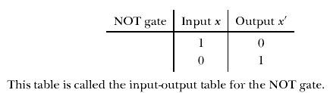
Logical Gates and Combinatorial Circuits

Slide 8
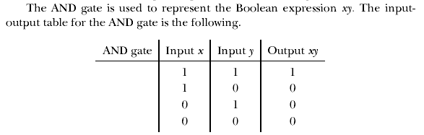
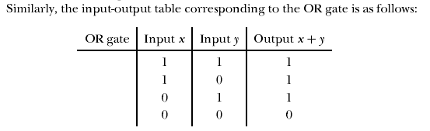

Slide 9




Slide 10
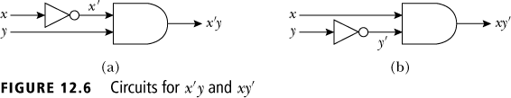
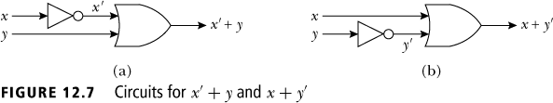

Slide 11
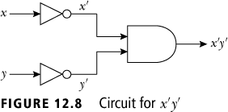
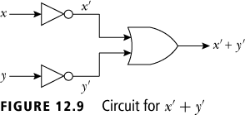

Slide 12
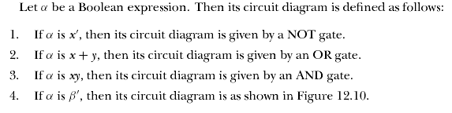



Slide 13




Slide 14
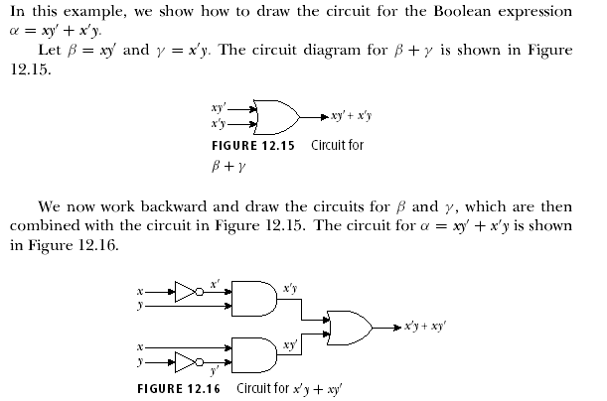

Slide 15

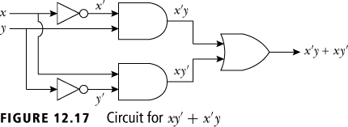

Slide 16
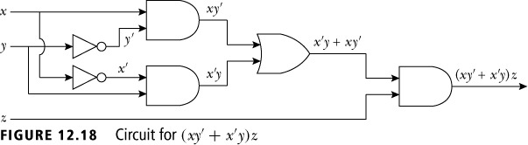
Draw a circuit diagram for δ = (xy' + x'y)z.

Slide 17
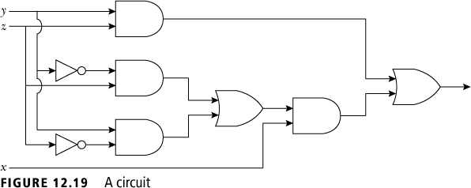

Slide 18
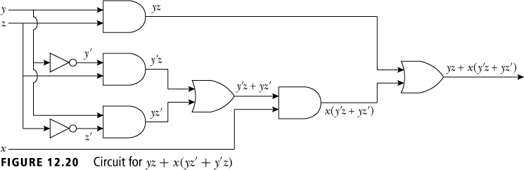

Slide 19
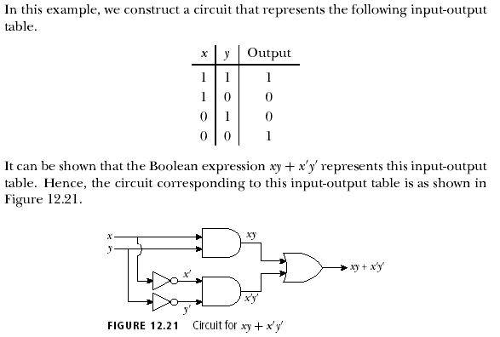

Slide 20
A circuit for two light switches
EXAMPLE 3, p. 714
F(x,y)=1 when the light is on
F(x,y)=0 when the light is off
When both switches are closed, the light is on:
F(1,1)=1, this implies
When we open one switch, the light is off:
F(1,0)=F(0,1)=0
When the other switch is also open, the light is on:
F(0,0)=1

Slide 21
Thus, we get:
x | y | F(x,y)
1 | 1 | 1
1 | 0 | 0
0 | 1 | 0
0 | 0 | 1
Which Boolean expression is given by F?
F(x,y) = xy + x'y'
Draw a circuit for F,
i.e., a circuit to control two light switches.

Slide 22
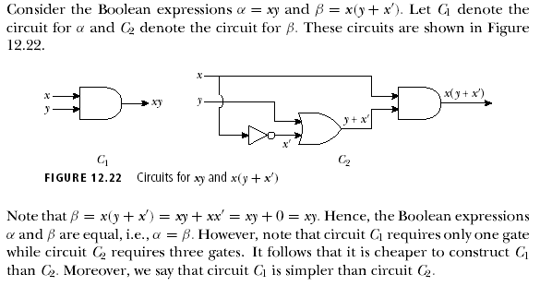

Slide 23

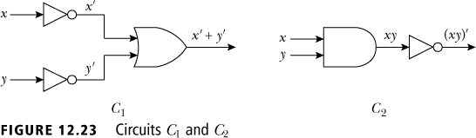
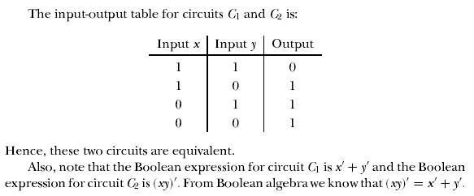

Slide 24

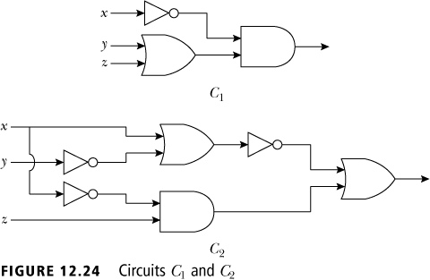
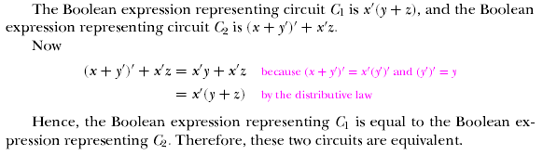

Slide 25
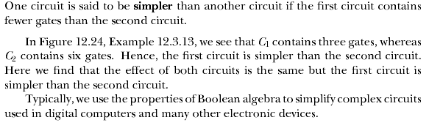

Slide 26
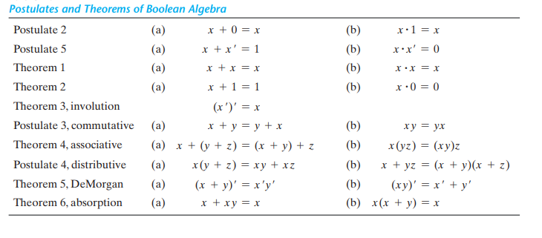
Boolean Algebra

Slide 27
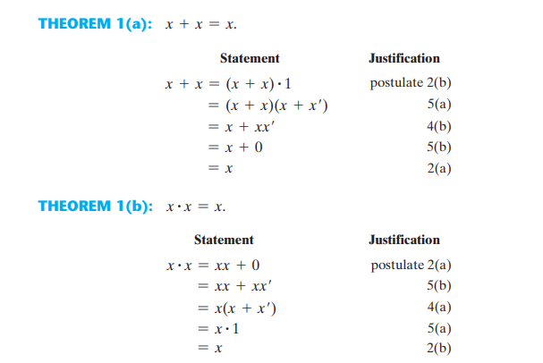
Boolean Algebra

Slide 28
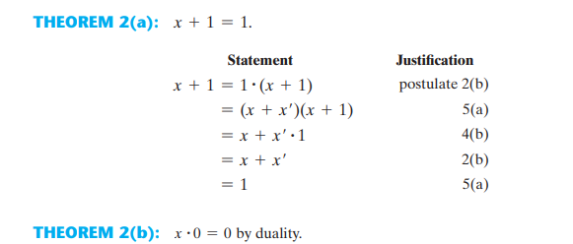
Boolean Algebra

Slide 29
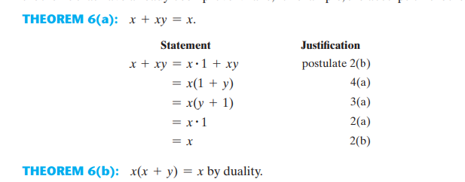
Boolean Algebra

Slide 30
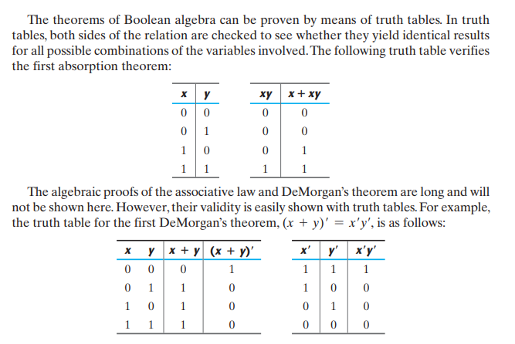
Boolean Algebra

Slide 31
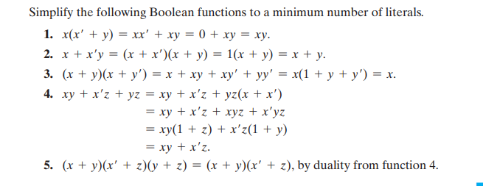
Boolean Algebra

Slide 32
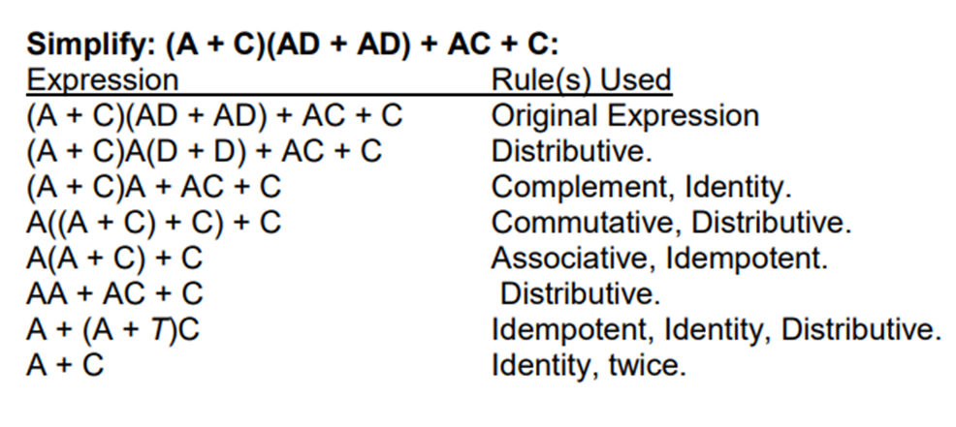
Boolean Algebra

Slide 33
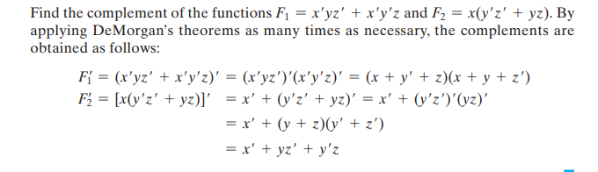
Boolean Algebra

Slide 34

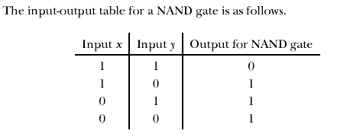

Slide 35


Slide 36
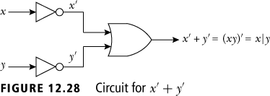


Slide 37

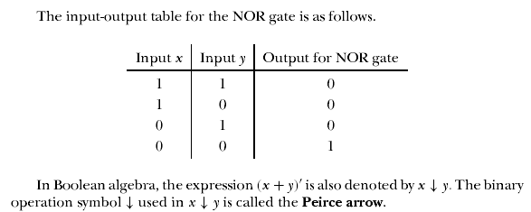

Slide 38


